Slide 1
dEepfake detection

Slide 2
AGENDA
Literature Review
Domains Involved in the project
Datasets involved in the project
Gap identification
Stimulation Study
Future Development
Research Paper And References

Slide 3
LITERATURE REVIEW
Paper1(DF40: Toward Next-Generation Deepfake Detection):
Aims to improve deepfake detection performance in real-world scenarios by addressing dataset bias and poor model generalization.
Introduces DF40, a large benchmark dataset with diverse manipulation types like face swap, editing, and synthesis.
Focuses on improving cross-dataset evaluation and detection of unseen deepfake techniques.
Enhances robustness and reliability of detection models across different datasets and practical
Paper2(Deepfake detection using deep learning methods: A systematic and comprehensive review):
Provides a comprehensive survey of deepfake detection methods using deep learning approaches.
Reviews CNN, RNN, GAN-based models and image, video, audio detection techniques.
Analyzes feature extraction methods such as visual, temporal, biological, and forensic features.
Identifies challenges like poor generalization, high computational cost, and lack of real-world deployment.

Slide 4
Paper3(Multi-Attentional Deepfake Detection 2021):
Improves detection accuracy using multiple attention mechanisms for fine-grained classification.
Focuses on detecting subtle local facial manipulation regions like eyes and mouth.
Uses spatial attention and texture enhancement to extract discriminative features.
Enhances detection performance for highly realistic deepfake images.
Paper4(Deepfake Detection Using Rate of Change Between Frames ,Sensors 2021):
Detects deepfake videos using temporal inconsistencies between consecutive frames.
Analyzes motion, texture, and facial changes caused by manipulation.
Uses frame extraction, feature comparison, and classification pipeline.
Improves video deepfake detection through temporal feature analysis instead of only spatial features.
Paper5(Hybrid ResNeXt + LSTM Deepfake Detection Model ,IJISRT 2025):
Combines spatial and temporal feature extraction using hybrid deep learning architecture.
Uses ResNeXt for frame-level visual features and LSTM for sequence analysis.
Detects visual inconsistencies and motion anomalies in videos.
Improves robustness and accuracy compared to single-model detection approaches.
Paper6(Deepfake Detection by Analyzing GAN Convolutional Traces ,CVPR Workshop):
Detects deepfake images using hidden GAN-generated convolutional fingerprints.
Extracts generation patterns using Expectation-Maximization algorithm.
Classifies real and fake images and identifies GAN architecture source.
Improves digital media forensics and explainable detection methods.

Slide 5
Paper7(Deepfake Video Detection: Challenges and Opportunities,2024):
Analyzes current challenges and limitations in deepfake detection techniques.
Highlights issues like poor generalization, limited dataset diversity, and high computation.
Examines data, training, and reliability challenges in detection systems.
Provides future research directions for robust and practical detection methods.
Paper8(DeepFake Detection Challenge (DFDC) Dataset / Systematic Review):
Introduces a large-scale dataset for training and evaluating deepfake detection models.
Provides realistic fake video samples for benchmarking detection performance.
Addresses challenges like class imbalance and evolving deepfake techniques.
Supports development of robust models for real-world deepfake detection.

Slide 6
Domains Involved In The Project
React (Frontend) :
Provides user interface for image/video upload and result display.
Computer Vision :
Detects faces and analyzes visual patterns.
Flask / FastAPI (Backend) :
Handles API requests and connects frontend with AI models.
GAN (Deep Learning Model) :
Uses Generator and Discriminator to detect real vs fake content.
Python Programming :
Implements preprocessing, model logic, and integration.
Explainable AI (Grad-CAM) :
Highlights suspicious manipulated regions in images or frames.
OpenCV (Video Processing) :
Extracts frames from videos for deepfake analysis.
Result & Risk Analysis :
Displays prediction, confidence score, and risk level.

Slide 7
Datasets Involved In The Project
DF40 Dataset
Introduced in DF40 (NeurIPS 2024).
Contains 1M+ images and 100K+ videos.
Includes 40 deepfake generation techniques.
FaceForensics++ Dataset
Used in DF40 study, Zhao et al. (CVPR 2021), Hybrid ResNeXt+LSTM model.
Contains manipulated facial videos for deepfake detection research.
Celeb-DF Dataset
Used in Zhao et al. and Hybrid model study.
High-quality celebrity deepfake videos.
ForgeryNet Dataset
Mentioned in DF40 literature review.
Large-scale forgery detection dataset.
CelebA Dataset
Used in GAN convolutional trace detection study.
Contains celebrity face images for training and testing.
AttGAN Generated Dataset
Used for evaluating GAN trace detection.
GDWCT Generated Dataset
Used in GAN-based deepfake analysis.
StyleGAN2 Generated Images
Used for fake image classification experiments
DeepFake Detection Challenge (DFDC) Dataset
Used in DFDC papers and Hybrid model study.
Contains 100K+ fake videos from thousands of actors.
Designed for real-world detection evaluation.
StyleGAN Generated Dataset
Used in GAN fingerprint detection experiments.
StarGAN Generated Dataset
Used for GAN architecture detection.

Slide 8
GAP IDENTIFICATION
Poor cross-dataset generalization is a major limitation, where detection models perform well on specific training datasets but fail to identify unseen or newly generated deepfake techniques. This issue is reported in DF40 (NeurIPS 2024), WIREs Survey (2023), Challenges & Opportunities (2024), DFDC dataset study, and Zhao et al. (CVPR 2021).
Most existing approaches rely mainly on visual features and lack multimodal detection that combines facial, audio, and behavioral information for improved accuracy. This gap is identified in WIREs Survey (2023), DF40 (2024), Sensors (2021), Zhao et al. (2021), and DFDC dataset research.
High computational complexity and heavy model architectures make many detection systems unsuitable for real-time implementation. This limitation is observed in the Hybrid ResNeXt + LSTM model (IJISRT 2025), Zhao et al. (2021), and WIREs Survey (2023).
Many studies lack real-time detection capability and are designed mainly for research purposes rather than practical deployment, as discussed in Sensors (2021), DFDC dataset study, and Challenges & Opportunities (2024).

Slide 9
Feasibility Analysis
Technical Feasibility
The project uses AI and Deep Learning technologies such as CNN, GAN, TensorFlow and OpenCV.
Public datasets, like Celeb-DF v1 and Celeb-DF v2, are available for model training.Google Collab and existing computer systems can be used for training and testing.
Required software tools are open source and easily available.
Economic Feasibility
Most of the tools and datasets used are free of cost.
No costly hardware or licensed software required.
Development cost is negligible and manageable for an academic project.
Operational Feasibility
The system can be useful in detecting fake/manipulated images/videos.
Useful in cyber security, verification of social media and prevention of misinformation.
User-friendly interface with easy real/fake prediction results.
Schedule Feasibility
The project can be finished within the academic schedule.
The work is divided into phases like data pre-processing, model training, testing and documentation.
Current progress includes Dataset preprocessing and model training on Celeb-DF v2 dataset.

Slide 10
STIMULATION STUDY
A simulation study was conducted using Celeb-DF v2 dataset containing both real and deepfake images/videos.
A structured database was created by organizing real and fake samples separately for efficient training and testing.
Data handling and filtering techniques were used to remove corrupted, duplicate, and low-quality samples from the dataset.
Data preprocessing steps included frame extraction using OpenCV, face cropping, image resizing, normalization, and tensor conversion.
Data augmentation methods such as horizontal flipping, color jittering, and Gaussian noise were applied to improve model robustness and reduce overfitting.
The system implemented a GAN-based Deepfake Detection framework using:
U-Net Generator
EfficientNet-B4 Discriminator
LSTM-based Video Discriminator for temporal analysis
Binary Cross Entropy Loss and L1 Loss functions were used during training for better classification and reconstruction performance.
Model evaluation was performed using Accuracy Score, F1-Score, AUC-ROC, ROC Curve, and Confusion Matrix analysis.
The proposed system achieved approximately 96% confidence/accuracy score in detecting deepfake media effectively.
Dataset Split
70% Dataset → Training
15% Dataset → Testing & Validation

Slide 11
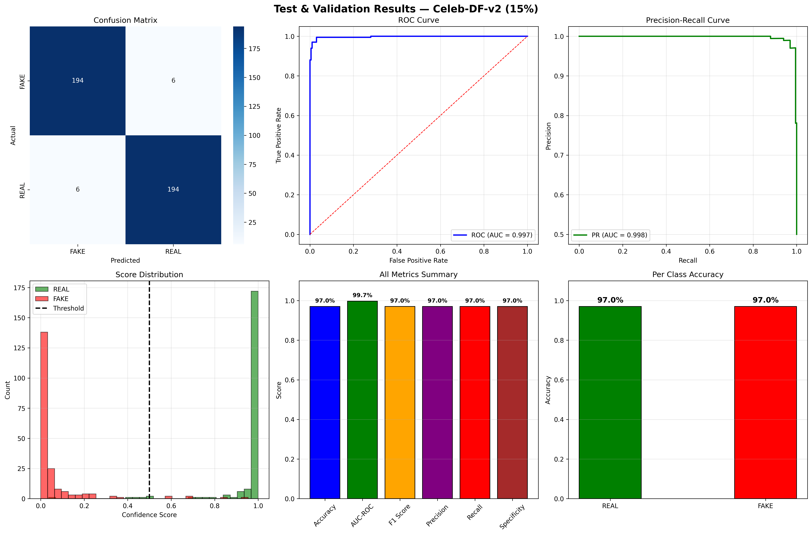
Performance Analysis and Evaluation Graphs

Slide 12
Future Development
Real-Time Platform Integration
Integrate detection into social media and streaming platforms to stop misinformation early.
Cross-Dataset Generalization
Improve model robustness to detect unseen manipulation techniques and new deepfake methods.
Lightweight Model Optimization
Develop efficient models with lower computational cost for faster and edge-device deployment.
Multimodal Detection
Extend the system to include multimodal deepfake detection for improved accuracy.
Enhanced Explainability
Improve heatmap visualization and provide clearer reasoning behind predictions for legal and security use.

Slide 13
Research Papers and References
Deepfake video detection: challenges and opportunities
DeepfakeBench: A Comprehensive Benchmark of Deepfake Detection
Deepfake Detection: A Systematic Literature Review
DF40: Toward Next-Generation Deepfake Detection
Deepfake Detection Using Deep Learning Methods
Multi-Attentional Deepfake Detection
Deepfake Detection Using the Rate of Change between Frames Based on Computer Vision
Hybrid ResNeXt and LSTM Model for Enhanced Deepfake Detection on the FaceForensics++ Dataset

Slide 14
THANK YOU

